Slide 1
Python List

Slide 2
Python List
A list in Python is used to store the sequence of various types of data.
Python lists are mutable type its mean we can modify its element after it created.
However, Python consists of six data-types that are capable to store the sequences, but the most common and reliable type is the list.
A list can be defined as a collection of values or items of different types.
The items in the list are separated with the comma (,) and enclosed with the square brackets [].
L1 = ["John", 102, "USA"]
L2 = [1, 2, 3, 4, 5, 6]

Slide 3
Characteristics of Lists -
The list has the following characteristics:
The lists are ordered.
The element of the list can access by index.
The lists are the mutable type.
The lists are mutable types.
A list can store the number of various elements.
Example –
emp = ["John", 102, "USA"]
print(“Name : %s” %(emp[0]))
print(“ID: %d” %(emp[1]))
print(“Country: %s” %(emp[2]))

Slide 4
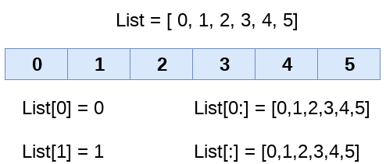
Example –
HOD_CS = [10,"Mr. Holding"]
print(“HOD Name: %s, Id: %d” %(HOD_CS[1],HOD_CS[0]))
List indexing and splitting –
The indexing is processed in the same way as it happens with the strings. The elements of the list can be accessed by using the slice operator []. The index starts from 0 and goes to length - 1. The first element of the list is stored at the 0th index, the second element of the list is stored at the 1st index, and so on.

Slide 5
Syntax –
list_varible (start : stop : step)
The start denotes the starting index position of the list.
The stop denotes the last index position of the list.
The step is used to skip the nth element within a start : stop
Example -
list = [1,2,3,4,5,6,7]
print(list[0])
print(list[1])
print(list[2])
print(list[3])
# Slicing the elements
print(list[0:6])
# By default the index value is 0
print(list[:])
print(list[2:5])
print(list[1:6:2])

Slide 6
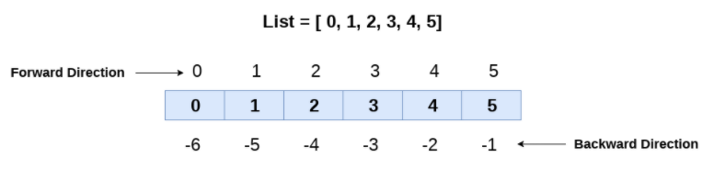
Example –
list = [1,2,3,4,5]
print(list[-1])
print(list[-3:])
print(list[:-1])
print(list[-3:-1])

Slide 7
list = [1, 2, 3, 4, 5, 6]
print(list)
# It will assign value to the value to the second index
list[2] = 10
print(list)
# Adding multiple-element
list[1:3] = [89, 78]
print(list)
# It will add value at the end of the list
list[-1] = 25
print(list)

Slide 8
Operator | Description | Example
Repetition | The repetition operator enables the list elements to be repeated multiple times. | L1*2 = [1, 2, 3, 4, 1, 2, 3, 4]
Concatenation | It concatenates the list mentioned on either side of the operator. | l1+l2 = [1, 2, 3, 4, 5, 6, 7, 8]
Iteration | The for loop is used to iterate over the list elements. | for i in l1: print(i)
Length | It is used to get the length of the list | len(l1) = 4
max(list) | It returns the maximum element of the list. | L1 = [12,34,26,48,72] print(max(L1))
min(list) | It returns the minimum element of the list. | L1 = [12,34,26,48,72] print(min(L1))

Slide 9
Iterating a List -
A list can be iterated by using a for - in loop. A simple list containing four strings, which can be iterated as follows.
list = ["John", "David", "James", "Jonathan"]
for i in list:
print(i)
Write the program to remove the duplicate element of the list.
list1 = [1,2,2,3,55,98,65,65,13,29]
list2 = []
for i in list1:
if i not in list2:
list2.append(i)
print(list2)

Slide 10
Write a program to find the sum of the element in the list.
list1 = [3,4,5,9,10,12,24]
sum = 0
for i in list1:
sum = sum+i
print("The sum is:",sum)
Write the program to find the lists consist of at least one common element.
list1 = [1,2,3,4,5,6]
list2 = [7,8,9,2,10]
for x in list1:
for y in list2:
if x == y:
print("The common element is:",x)

